Slide 1
NOISE POLLUTION MONITORING SYSTEMS

Slide 2
INTRODUCTION
Noise pollution is a pervasive environmental issue that can have detrimental effects on human health, wildlife, and overall quality of life. To address this concern, various noise pollution monitoring systems have been developed. These systems play a crucial role in assessing, managing, and mitigating noise pollution in urban, industrial, and residential areas. In this introduction, we will explore the fundamental aspects of a noise pollution monitoring system.

Slide 3
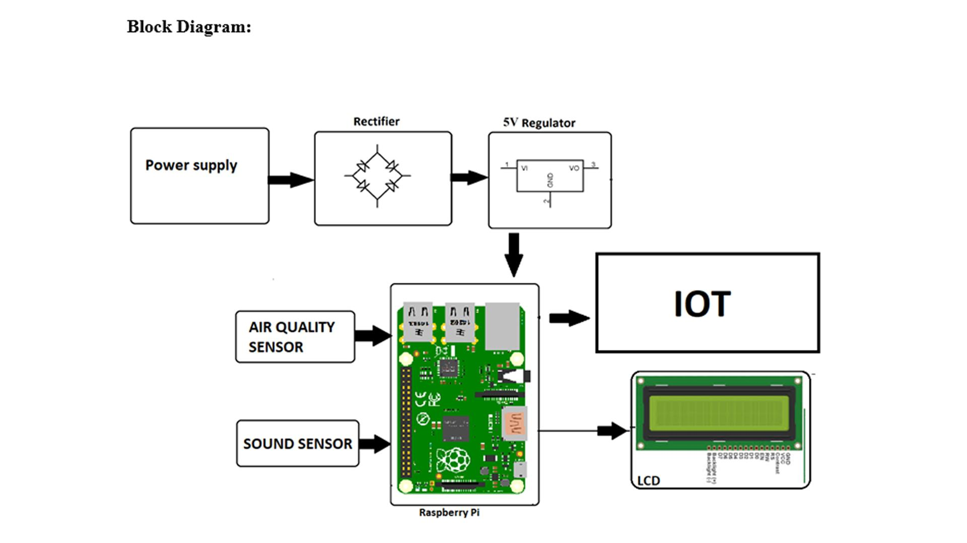

Slide 4
COMPONENTS WORKING PROCEDURE
Sensor Selection: Choose appropriate noise sensors, such as microphones or sound level meters, that can accurately measure noise levels in the environment. Data Collection: Install sensors in strategic locations to collect noise data continuously or periodically. Data Processing: Process the collected data to calculate various noise metrics like L10 (the noise level exceeded for 10% of the time), L50, L90, and overall Leq (equivalent continuous noise level). Data Storage: Store the processed data in a database or cloud storage for analysis and future reference. Data Analysis: Analyze the noise data to identify patterns, trends, and areas with excessive noise pollution. This can involve statistical analysis and visualization techniques. Alerting and Reporting: Set up alerting mechanisms to notify relevant authorities or stakeholders when noise levels exceed predefined thresholds. Generate regular reports to document noise pollution levels. GIS Integration: If necessary, integrate noise data with Geographic Information Systems (GIS) to map noise pollution levels spatially

Slide 5
Public Engagement: Share noise pollution data with the public through websites or mobile apps, promoting awareness and citizen engagement. Regulatory Compliance: Ensure compliance with local noise regulations and standards, and use the data for enforcement if necessary. Maintenance: Regularly maintain and calibrate sensors to ensure data accuracy. Feedback Loop: Use the collected data to implement noise reduction strategies, like traffic management or noise barriers, and monitor their effectiveness. Privacy Considerations: Address privacy concerns when collecting and sharing noise data, as it may include sensitive information.

Slide 6
CONCLUSION
In conclusion, the development and implementation of Noise Pollution Monitoring Systems (NPMS) represent a crucial step in addressing the pervasive issue of noise pollution in our modern world. These systems, enabled by IoT technology, provide real-time data collection, analysis, and reporting, empowering communities and authorities to make informed decisions for noise pollution control and mitigation.NPMS not only assist in assessing compliance with noise regulations but also serve as early warning systems, identifying noise sources and trends before they become severe. With the ability to monitor noise levels continuously and remotely, these systems offer an efficient means of reducing the adverse effects of noise pollution on human health and the environment.

